Slide 1
Deep Learning - Tensors
Alicia Gonzalez Cruz
ITAI 2376
Prof. Anna Devarakonda

Slide 2
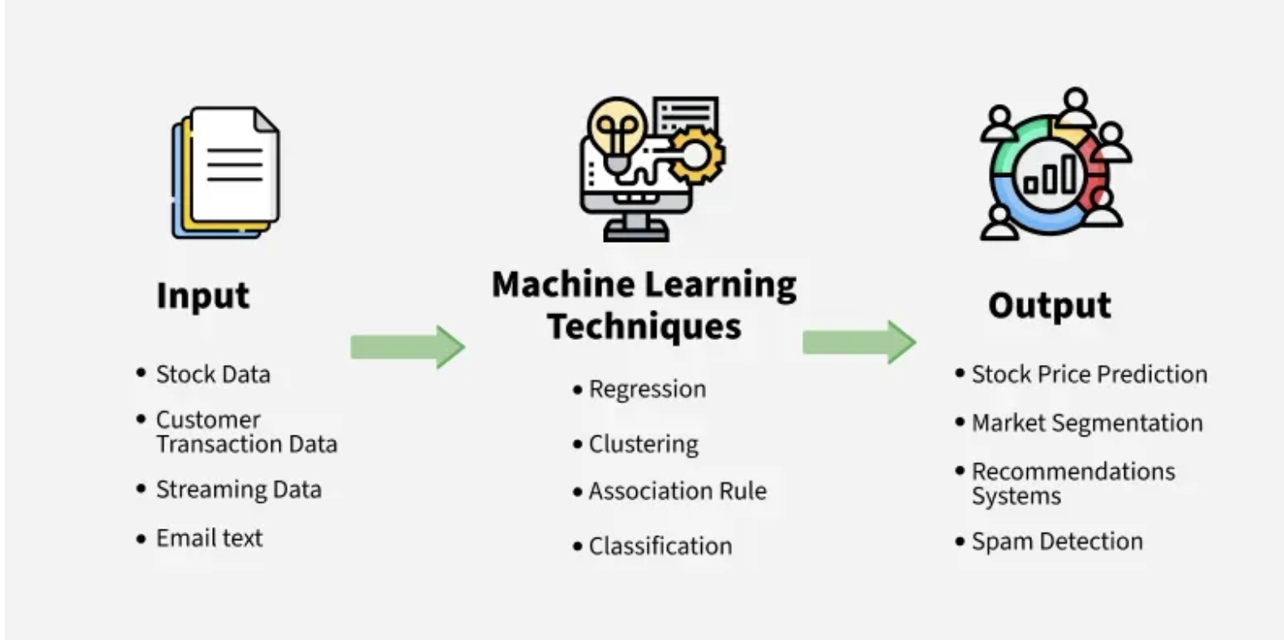
What is Machine Learning?
It is when we teach computers to learn from data, like giving them lots of Examples so they can figure things out on their own (without being told every step).
Example: if you show a computer lots of pictures of cats and dogs, it can learn to tell the difference — all by itself!
🐱
🐶
🐈
CAT
💻
➡️
➡️
🐱
🐶
🐕
DOG

Slide 3
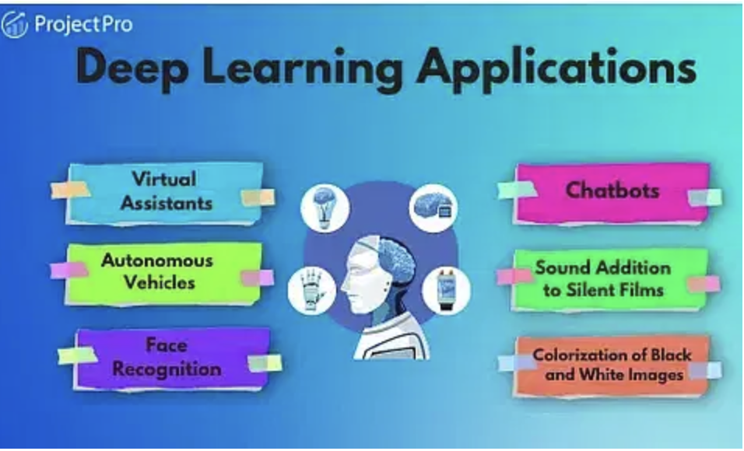
What is Deep Learning?
How does it work?
Deep Learning helps computers learn and understand things like the human brain, so they can do things like recognize pictures, understand language, and hear speech.
Deep learning is a special kind of AI where the computer learns by itself from lots of examples. Just like we as humans learn from practice or reading.

Slide 4

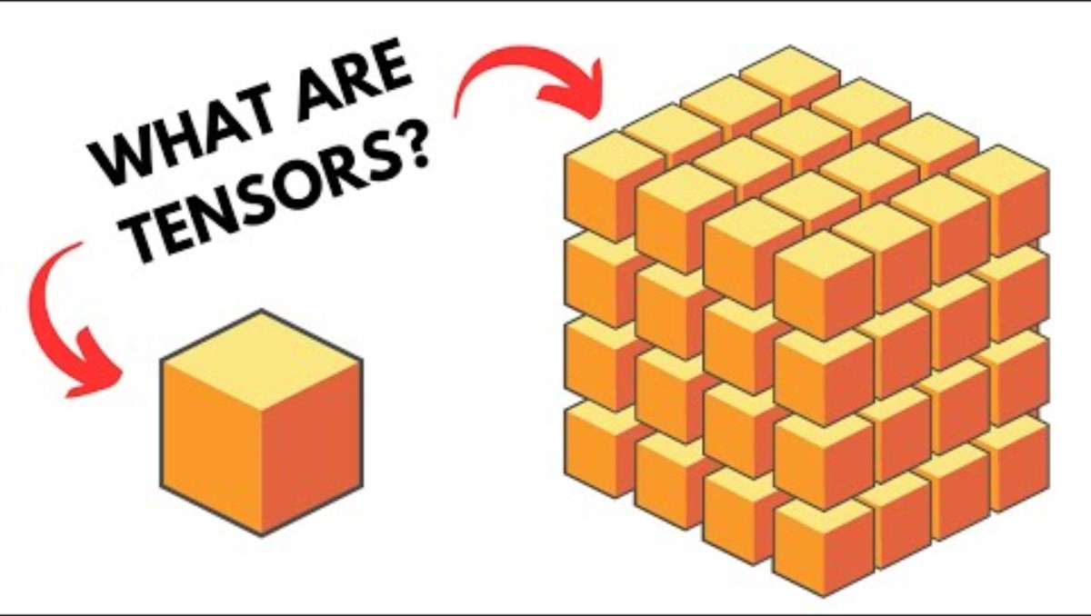

Slide 5
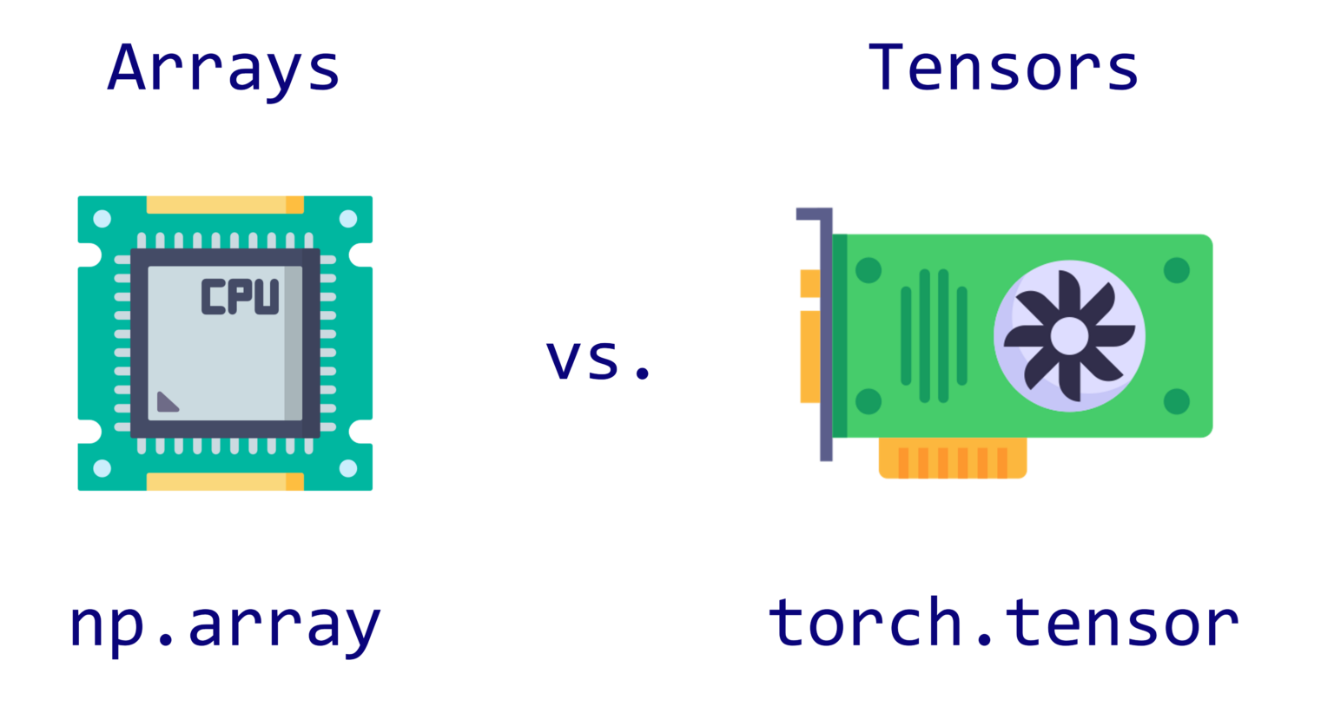
What are Tensors?
A tensor is just a fancy word for data, like numbers, organized in shapes.
You can think of it like boxes or cubes that hold numbers.
Why Do We Use Tensors in Deep Learning?
In deep learning, we give the computer lots of data, like:
Pictures (as grids of numbers for color)
Words (as sequences of numbers)
Sounds (as waves of numbers)
Why Use Tensors?
Tensors are particularly useful for handling complex data such as images, audio, and text. For example, a color image can be represented as a 3D tensor with dimensions corresponding to height, width, and color channels (red, green, and blue).

Slide 6


Why Tensors Matter in AI:
"Tensors are how computers see and think about the world."
In games, they help AI see images or understand sounds.
In chatbots, tensors help understand sentences.
In robots, tensors help them see and react.
Examples of Tensors:
A single number is a 0D tensor (like a dot).
A list of numbers is a 1D tensor (like a line).
A table (rows and columns) is a 2D tensor (like a grid).
A bunch of tables stacked together is a 3D tensor (like a cube or block).
Think of a tensor like LEGO blocks—you can build simple or super complex stuff by stacking them the right way!

Slide 7
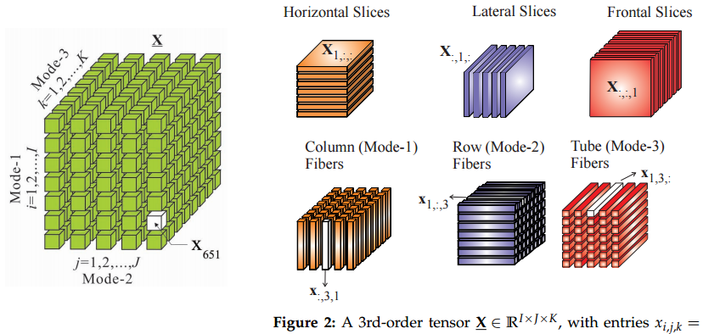

Slide 8
Citations
Brownlee, J. (2018, February 13). A Gentle Introduction to Tensors for Machine Learning with NumPy. Machine Learning Mastery. https://machinelearningmastery.com/introduction-to-tensors-for-machine-learning/
Deep Learning with Yacine. (2024, July 2). What are Tensors in Deep Learning? YouTube. https://www.youtube.com/watch?v=lMG5O6cezKA
GeeksforGeeks. (2018, May). What is Machine Learning? GeeksforGeeks. https://www.geeksforgeeks.org/machine-learning/ml-machine-learning/
IBM. (2021, September 22). What Is Machine learning? Ibm.com; IBM. https://www.ibm.com/think/topics/machine-learning
Labonne, M. (2022, March 29). What is a Tensor in Machine Learning? | Towards Data Science. Towards Data Science. https://towardsdatascience.com/what-is-a-tensor-in-deep-learning-6dedd95d6507/
ProjectPro. (2022, January 18). 10 Deep Learning Applications in Artificial Intelligence. ProjectPro. https://www.projectpro.io/article/common-applications-of-deep-learning-in-ai/548
Tensor. (2019, May 17). DeepAI. https://deepai.org/machine-learning-glossary-and-terms/tensor

